Slide 1

Programming in Java

Slide 2
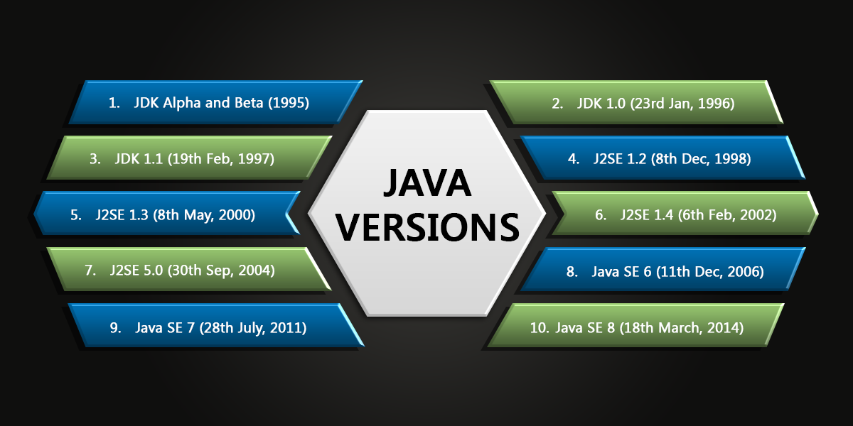
1. Introduction & Fundamentals of Java
Java is a high-level, object-oriented programming language developed by Sun Microsystems (now Oracle) in 1995. It is designed to be simple, secure, and platform-independent. The language achieves platform independence through the Java Virtual Machine (JVM), which allows compiled Java programs (bytecode) to run on any operating system.

Slide 3
Features:
• Object-Oriented: Everything in Java is treated as an object.
• Platform-Independent: ", which promotes modularity and reuse.
Programs written in Java can run on any platform that has a JVM, adhering to the "Write Once, Run Anywhere."
• Robust: Exception handling and garbage collection make programs stable" philosophy.
Java includes strong memory management, exception handling, and type-checking mechanisms.
• Secure: Offers runtime environment checks and bytecode verification.
• Multi-threaded: Allows simultaneous execution of multiple parts of a program, bytecode verification, and protection against memory corruption.

Slide 4
• High Performance: The Just-In-Time (JIT) compiler enhances performance by converting bytecode into native machine code at runtime.
• Distributed: Java supports remote method invocation (RMI) and facilitates the creation of distributed systems.
Everything in Java is treated as an object.

Slide 5
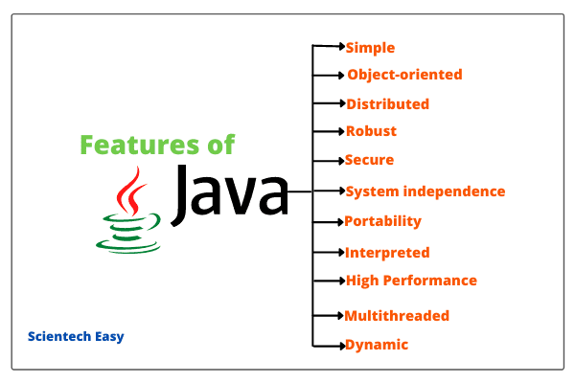

Slide 6
Example:
public class HelloWorld {
public static void main(String[] args) {
System.out.println("Hello, World!");
}
}

Slide 7
Programming Questions:
1. Easy: Write a program to print "Hello, Java World!"
2. Medium: Write a program to calculate the sum of two numbers entered by the user.
3. Hard: Implement a program to check if a given number is prime.
4. Very Hard: Write a program to build a simple calculator supporting +, -, *, / using command-line arguments.
________________________________________

Slide 8
Background of Java
History:
• Developed by James Gosling and his team at Sun Microsystems.
• Released in 1995.
• Initially named "Oak," later renamed "Java" after Java coffee in 1991.
• Originally called "Oak," the name was changed to "Java" in 1995 after Java coffee.
• The first public implementation, Java 1.0, was released in 1996.
________________________________________

Slide 9
About Java Technology
Java Editions:
1. Java Standard Edition (SE): Core functionalities for desktop and server applicationslike data structures, networking, and concurrency.
2. Java Enterprise Edition (EE): For web and Tools for developing scalable, distributed, and secure enterprise applications.
3. Java Micro Edition (ME): Targeted for embedded and mobileOptimized for embedded systems and constrained devices.
Key Components:
• JVM: Executes bytecode.
• JRE: Includes JVM and libraries.
• JDK: Development kit for JavaJava Development Kit (JDK): A bundle containing the compiler, debugger, and libraries for development.
• Java Runtime Environment (JRE): Required to run Java applications, it includes the JVM and runtime libraries.
• Java Virtual Machine (JVM): Converts bytecode into machine code for execution.

Slide 10
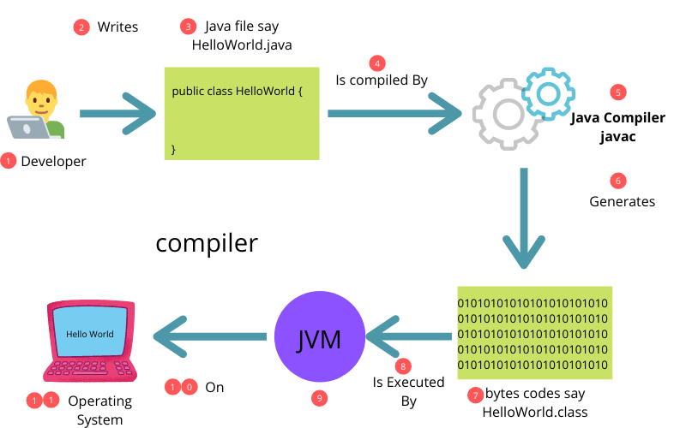
Java’s Architecture

Slide 11
Java’s Architecture
Components:
1. Class Loader: LoadsDynamically loads classes into memory when needed.
2. Bytecode Verifier: Ensures bytecode is validthe correctness and security of bytecode before execution.
3. Execution Engine: Converts bytecode into machine codenative machine code using either an interpreter or a JIT compiler.
4. Garbage Collector: Manages memory by cleaningAutomatically manages memory by deallocating unused objects.
Execution Flow:
1. Java source code is compiled into bytecode.
2. Bytecode is executed by the JVM by the Java compiler.
3. The JVM executes the bytecode, ensuring platform independence.
________________________________________

Slide 12
Reading Console Inputs
Methods:
1. Scanner: For reading user input easily.
2. BufferedReader: For efficient reading of large inputs.Provides methods for input parsing.
3. BufferedReader: Efficient for large input streams, though requires more boilerplate code.
4. Console Class: Useful for secure input like passwords.

Slide 13
Example:
import java.util.Scanner;
public class InputExample {
public static void main(String[] args) {
Scanner sc = new Scanner(System.in);
System.out.print("Enter your name: ");
String name = sc.nextLine();
System.out.println("Hello, " + name);
}
}

Slide 15
Programming Questions:
1. Easy: Write a program to read and display user input.
2. Medium: Accept a list of names and display them in reverse.
3. Hard: Read user input until "exit" is entered.
4. Very Hard: Create a multi-threaded program for reading inputs from multiple users.
________________________________________

Slide 16
Arrays
An array is a data structure used to store multiple values of the same type in a single variable. Arrays are helpful when you need to manage a collection of related data efficiently.
Characteristics of Arrays
• Fixed Size: The size of an array is defined at the time of creation and cannot be changed later.
• Indexed Access: Elements in an array are accessed using a 0-based index.
• Homogeneous Data: An array can only store elements of the same data type.
• Efficient Access: Arrays provide constant-time access to elements using their index.
Example:
public class ArrayExample {
public static void main(String[] args) {
int[] numbers = {1, 2, 3, 4, 5};
for (int num : numbers) {
System.out.println(num);
}
}
}

Slide 17
Programming Questions:
1. Easy: Write a program to store and display 5 integers.
2. Medium: Sort an array of integers.
3. Hard: Find the second largest number in an array.
4. Very Hard: Implement matrix multiplication.

Slide 18
Constructors
Types:
1. Default Constructor: No arguments, initializes default values.
2. Parameterized Constructor: Accepts parameters to initialize object properties.
3. Copy Constructor: Copies an objectCreates a new object as a copy of an existing one.
Default Constructor
A constructor that has no arguments and initializes the object with default values.
• Characteristics:
o Automatically provided by Java if no constructor is explicitly defined.
o Initializes primitive fields to default values (e.g., 0 for numbers, null for objects, false for boolean).

Slide 19
class Student {
int id;
String name;
// Default Constructor
Student() {
id = 0;
name = "Unknown";
}
void display() {
System.out.println("ID: " + id + ", Name: " + name);
}
}
public class Main {
public static void main(String[] args) {
Student s1 = new Student();
s1.display(); // Output: ID: 0, Name: Unknown
}

Slide 20
2. Parameterized Constructor
A constructor that accepts arguments to initialize object properties with specific values.
o Useful for initializing objects with custom values.
o Parameters are passed when the object is created.
• Example:
class Student {
int id;
String name;
// Parameterized Constructor
Student(int id, String name) {
this.id = id;
this.name = name;
}
void display() {
System.out.println("ID: " + id + ", Name: " + name);
}
}
public class Main {
public static void main(String[] args) {
Student s1 = new Student(101, "John");
s1.display(); // Output: ID: 101, Name: John
}

Slide 21
3. Copy Constructor
constructor that creates a new object as a copy of an existing object.
o Often implemented manually in Java (unlike in languages like C++).
o Copies the values of fields from one object to another.
• Example:
class Student {
int id;
String name;
// Parameterized Constructor
Student(int id, String name) {
this.id = id;
this.name = name;
}
// Copy Constructor
Student(Student s) {
this.id = s.id;
this.name = s.name;
}
void display() {
System.out.println("ID: " + id + ", Name: " + name);
}
}
public class Main {
public static void main(String[] args) {
Student s1 = new Student(102, "Alice");
Student s2 = new Student(s1); // Copy Constructor is called
s2.display(); // Output: ID: 102, Name: Alice
}
}

Slide 22
Programming Questions:
1. Easy: Create a class with a default constructor.
2. Medium: Initialize an object using a parameterized constructor.
3. Hard: Overload constructors.
4. Very Hard: Use copy constructors for deep cloning.

Slide 23
Finalize Method in Java
The finalize() method in Java is a part of the Object class and is used to perform cleanup operations before an object is garbage collected.
________________________________________
1. Definition
• The finalize() method is called by the Garbage Collector (GC) on an object when it determines that there are no more references to that object.
• Its primary purpose is to allow the object to release resources, such as closing files, releasing network connections, or performing other cleanup tasks before the object is destroyed.
________________________________________
2. Syntax
java
Copy code
protected void finalize() throws Throwable {
// Cleanup code
}

Slide 24
Key Points
1. Invocation by GC:
The Garbage Collector calls finalize() during garbage collection, but this is not guaranteed.
2. Override in Subclasses:
You can override the finalize() method to include your cleanup logic.
3. One-Time Execution:
The method is called at most once by the Garbage Collector for an object.
4. Not a Destructor:
Unlike destructors in other languages (like C++), finalize() is not deterministic and should not be relied upon for releasing resources.

Slide 25
Programming Questions:
1. Easy: Write a program using finalize to display a message.
2. Medium: Demonstrate memory cleanup using finalize.
3. Hard: Force garbage collection to invoke finalize.
4. Very Hard: Simulate resource management with finalize.
________________________________________

Slide 26
final in Java
The final keyword is used to declare constants, prevent inheritance, or disallow method overriding.
Uses of final:
1. Final Variables
o Once assigned, a final variable's value cannot be changed.
class Example {
final int MAX = 100;
void display() {
// MAX = 200; // Error: Cannot assign a value to final variable
System.out.println("MAX: " + MAX);
}
}

Slide 27
2. Final Methods
o A method declared as final cannot be overridden by subclasses.
class Parent {
final void display() {
System.out.println("This is a final method.");
}
}
class Child extends Parent {
// void display() { } // Error: Cannot override the final method
}

Slide 28
3. Final Classes
o A final class cannot be extended.
final class Utility {
void display() {
System.out.println("This is a final class.");
}
}
// class SubUtility extends Utility { } // Error: Cannot inherit from final class

Slide 29
this Keyword in Java
The this keyword is used to refer to the current instance of the class.
Uses of this:
1. Accessing Instance Variables
o Resolves ambiguity between instance variables and parameters.
class Example {
int id;
Example(int id) {
this.id = id; // Refers to the instance variable
}
void display() {
System.out.println("ID: " + this.id);
}
}

Slide 30
2. Calling Another Constructor
o Use this() to call another constructor within the same class.
class Example {
int id;
String name;
Example(int id) {
this.id = id;
}
Example(int id, String name) {
this(id); // Calls the single-parameter constructor
this.name = name;
}
void display() {
System.out.println("ID: " + id + ", Name: " + name);
}
}

Slide 31
Static Members in Java
The static keyword is used to declare members that belong to the class rather than to any specific instance.
Uses of static:
1. Static Variables
o A static variable is shared among all instances of a class.
class Example {
static int count = 0;
Example() {
count++;
}
static void displayCount() {
System.out.println("Count: " + count);
}
}

Slide 32
2. Static Methods
o Static methods belong to the class and can be called without creating an instance.
o They cannot access non-static variables directly.
class Example {
static void display() {
System.out.println("This is a static method.");
}
}
public class Main {
public static void main(String[] args) {
Example.display(); // No object needed
}
}

Slide 33
3. Static Blocks
o A static block is executed once when the class is loaded into memory.
class Example {
static int num;
static {
num = 100; // Static block for initialization
System.out.println("Static block executed.");
}
}

Slide 34
Programming Questions:
1. Easy: Use final to create a constant.
2. Medium: Use this to resolve variable shadowing.
3. Hard: Demonstrate static members.
4. Very Hard: Design a Singleton class using static members

Slide 35
UNIT 2

Slide 37
1. Concrete Class
A concrete class in Java is a class that has complete implementation and can be instantiated directly. It contrasts with abstract classes and interfaces, which serve as blueprints.
Key Characteristics:
1. All methods must have bodies (implemented).
2. Can inherit from other classes (single inheritance).
3. Can implement one or more interfaces.
Use Cases:
• Representing real-world objects (e.g., a Car class with methods like start() and stop()).
• Providing reusable components.

Slide 38
Example:
public class Calculator
{
public int add(int a, int b)
{
return a + b;
}
public int subtract(int a, int b)
{
return a - b;
}
}

Slide 39
Programming Questions:
1. Easy: Create a class Person with properties like name and age. Add methods to display these.
2. Medium: Implement a concrete class BankAccount with methods for deposit, withdrawal, and balance check.
3. Hard: Create a concrete class Employee with fields id, name, and department. Add a method to calculate the yearly salary.
4. Very Hard: Build a class GameEngine that simulates a basic game environment with methods for initializing, updating, and rendering the game.

Slide 40
2. Abstract Class
An abstract class in Java is a class that cannot be instantiated directly. It is meant to be extended by other classes and can have both abstract methods (without implementation) and concrete methods (with implementation).
Key Characteristics:
1. Can have constructors, fields, and concrete methods.
2. Subclasses must implement all abstract methods.
3. Provides partial implementation for related classes.
Advantages:
• Code reuse.
• Abstraction to define a base for polymorphism.

Slide 41
abstract class Shape {
abstract void draw();
void display() {
System.out.println("This is a shape.");
}
}
class Circle extends Shape {
void draw() {
System.out.println("Drawing a Circle.");
}
}

Slide 42
Programming Questions:
1. Easy: Create an abstract class Shape with an abstract method draw(). Implement it in a Circle class.
2. Medium: Design an abstract class Vehicle with concrete methods for common functionalities like start() and abstract methods for specific behaviors.
3. Hard: Implement a game simulation with an abstract class Character and subclasses like Warrior and Mage.
4. Very Hard: Develop a library management system where abstract classes define entities like Item (books, magazines).

Slide 43
3. Interface
An interface in Java is a contract that specifies a set of methods a class must implement.
Key Characteristics:
1. All methods are implicitly public and abstract (except default and static methods).
2. Interfaces support multiple inheritance.
3. Fields are public, static, and final by default.
Example:
interface Animal {
void makeSound();
}
class Dog implements Animal {
public void makeSound() {
System.out.println("Bark!");
}
}

Slide 44
Programming Questions:
1. Easy: Define an interface Animal and implement it in a Dog class.
2. Medium: Create an interface Calculator with methods for basic arithmetic operations. Implement it in a class.
3. Hard: Use multiple interfaces to model a hybrid vehicle system.
4. Very Hard: Build a payment system using an interface for payment gateways like CreditCard and PayPal

Slide 45
4. Inner Classes
Inner classes are defined within another class and provide better encapsulation and logical grouping.
Types:
1. Non-static Nested Class (Inner Class): Associated with an instance of the outer class.
2. Static Nested Class: Acts like a static member of the outer class.
3. Local Inner Class: Defined within a method or a block.
4.Anonymous Inner Class: A one-time use class defined and instantiated simultaneously.
Example:
class Outer {
class Inner {
void display() {
System.out.println("This is an inner class.");
}
}
}

Slide 46
Programming Questions:
1. Easy: Create a class with a non-static inner class that displays a message.
2. Medium: Implement a static nested class to handle utility methods.
3. Hard: Use an anonymous inner class to handle an event in a GUI.
4. Very Hard: Combine multiple types of inner classes to model a real-world hierarchy.

Slide 47
5. Aggregation and Composition
Aggregation:
A weak association where the contained object can exist independently of the container object.
Composition:
A strong association where the lifecycle of the contained object depends on the container object.

Slide 48
Aggregation:
class Address
{
String city, state;
}
class Employee
{
Address address;
}
Composition:
class Engine
{
Engine()
{
System.out.println("Engine created");
}
}
class Car
{
Engine engine = new Engine();
}

Slide 49
Programming Questions:
1. Easy: Create a Student class that uses aggregation to store Address.
2. Medium: Design a Car class that uses composition for its Engine.
3. Hard: Model a company’s hierarchy using aggregation and composition.
4. Very Hard: Combine aggregation and composition to simulate a library system.

Slide 50
6. Inheritance
Inheritance allows one class (child) to acquire the properties and methods of another class (parent).
Types:
• Single
• Multilevel
• Hierarchical

Slide 51
Example:
class Parent
{
void display()
{
System.out.println("This is the parent class.");
}}
class Child extends Parent
{
void show()
{
System.out.println("This is the child class.");
}}

Slide 52
Programming Questions:
1. Easy: Implement single inheritance.
2. Medium: Create a multilevel inheritance example.
3. Hard: Design a family tree using hierarchical inheritance.
4. Very Hard: Combine inheritance with polymorphism for a role-based system.

Slide 53
Super Method and Reference
The super keyword in Java is used to:
Access Parent Class Variables: When a child class has a variable with the same name as in the parent class.
Call Parent Class Methods: To access a method from the parent class that is overridden in the child class.
Invoke Parent Class Constructor: To explicitly call the parent class constructor (default or parameterized).

Slide 54
void showMessages() {
System.out.println(super.message); // Access Parent's variable
System.out.println(this.message); // Access Child's variable
}
}
// Main class
public class SuperExample {
public static void main(String[] args) {
Child child = new Child("John");
child.displayMessage();
child.showMessages();
}
}
// Parent class
class Parent {
String message = "Message from Parent Class";
Parent(String name) {
System.out.println("Parent Constructor Called by: " + name);
}
void displayMessage() {
System.out.println("Hello from Parent!");
}
}
// Child class
class Child extends Parent {
String message = "Message from Child Class";
Child(String name) {
super(name); // Calls Parent class constructor
}
void displayMessage() {
super.displayMessage(); // Calls Parent's displayMessage method
System.out.println("Hello from Child!");
}

Slide 55
Parent Constructor Called by:
John Hello from Parent!
Hello from Child!
Message from Parent Class
Message from Child Class

Slide 56
Method Overloading
Method overloading occurs when two or more methods in the same class have the same name but different parameter lists (different number or types of parameters).
It is an example of compile-time polymorphism, as the method to execute is determined during compilation.
Key Features:
Same Name, Different Parameters: Methods have the same name but differ in the number of arguments, data types, or the order of parameters.
Return Type: The return type of the method can be different, but it does not affect the overloading. Overloading is determined solely by the method signature (name + parameters).
Flexibility: Overloading allows methods to handle different types or numbers of arguments, making code more readable and flexible.

Slide 57
Example 1: Overloading with Different Number of Parameters:
class OverloadingExample {
// Method with two parameters
int add(int a, int b) {
return a + b;
}
// Overloaded method with three parameters
int add(int a, int b, int c) {
return a + b + c;
}
public static void main(String[] args) {
OverloadingExample obj = new OverloadingExample();
System.out.println("Sum of two numbers: " + obj.add(10, 20));
System.out.println("Sum of three numbers: " + obj.add(10, 20, 30));
}
}
Output:
Sum of two numbers: 30
Sum of three numbers: 60

Slide 58
Example 2: Overloading with Different Parameter Types:
class OverloadingExample {
// Method with integer parameters
int multiply(int a, int b) {
return a * b;
}
// Overloaded method with double parameters
double multiply(double a, double b) {
return a * b;
}
public static void main(String[] args) {
OverloadingExample obj = new OverloadingExample();
System.out.println("Product of integers: " + obj.multiply(5, 10));
System.out.println("Product of doubles: " + obj.multiply(5.5, 2.2));
}
}
Output:
Product of integers: 50
Product of doubles: 12.1

Slide 59
2. Method Overriding
Method overriding occurs when a subclass provides a specific implementation of a method that is already defined in its superclass.
It is an example of runtime polymorphism, as the method to execute is determined during runtime.
Key Features:
Same Name and Parameters:
The overriding method in the subclass must have the same name, return type, and parameters as the method in the superclass.
Annotation: The @Override annotation is used to ensure the method is correctly overriding a parent method.
Access Modifier: The access level of the overriding method in the subclass cannot be more restrictive than the method in the superclass.
For example, if the parent class method is protected, the overriding method cannot be private.
Dynamic Method Dispatch:
During runtime, the object type determines which version of the method is called (parent or child)

Slide 60
Rules for Overriding:
Only instance methods can be overridden; static methods cannot (they are hidden).
The overriding method can throw fewer or no exceptions but cannot throw new, broader checked exceptions.

Slide 61
Example 1: Basic Method Overriding:
class Parent {
void display() {
System.out.println("Display method from Parent class");
}}
class Child extends Parent {
@Override
void display() {
System.out.println("Display method from Child class");
}}
public class OverridingExample {
public static void main(String[] args) {
Parent obj = new Child(); // Polymorphism
obj.display(); // Calls the overridden method in Child class
}}
Output:
Display method from Child class

Slide 62
Example 2: Overriding with Access Modifiers:
class Animal {
void sound() {
System.out.println("Some generic animal sound");
}}
class Dog extends Animal {
@Override
public void sound() { // Less restrictive access modifier (public)
System.out.println("Bark");
}}
public class AccessModifierExample {
public static void main(String[] args) {
Animal obj = new Dog();
obj.sound();
}}
Output:
Bark

Slide 63
Example 3: Overriding and super Keyword:
class Parent {
void display() {
System.out.println("Parent's display method");
}}
class Child extends Parent {
@Override
void display() {
super.display(); // Calls the parent class method
System.out.println("Child's display method");
}}
public class SuperInOverriding {
public static void main(String[] args) {
Child obj = new Child();
obj.display();
}}
Output:
Parent's display method
Child's display method

Slide 64
Singleton Classes in Java :
A Singleton class is a class that allows only one instance to exist throughout the lifecycle of an application.
It provides global access to this instance via a static method.
Why Use Singleton Classes?
Resource Management: Ensure a single point of control for critical resources like database connections, file systems, or logging systems.
Global Access: Provide a shared, globally accessible instance without the need to create multiple objects.
Memory Efficiency: Prevent multiple instances of a class that consume extra memory.
Consistency: Maintain consistent state across multiple parts of an application, as only one instance is used.
Key Features of Singleton Class
Private Constructor: Prevents instantiation from outside the class.
Static Instance: A single instance of the class is stored in a static variable.
Static Method: Provides a global access point to retrieve the single instance.

Slide 65
Implementation Steps
Declare a Private Static Variable: This holds the reference to the single instance of the class.
Make the Constructor Private: Restricts instantiation from other classes.
Provide a Public Static Method: Returns the single instance of the class. If the instance doesn’t exist, it is created lazily.

Slide 66
Example: Basic Singleton Implementation
class Singleton {
// Static variable to hold the single instance
private static Singleton instance;
// Private constructor to prevent instantiation
private Singleton() {
System.out.println("Singleton instance created.");
}
// Public static method to provide access to the single instance
public static Singleton getInstance() {
if (instance == null) {
instance = new Singleton(); // Lazy initialization
}
return instance;
}}
public class SingletonExample {
public static void main(String[] args) {
Singleton obj1 = Singleton.getInstance();
Singleton obj2 = Singleton.getInstance();
// Verify that both references point to the same instance
System.out.println("Are obj1 and obj2 the same? " + (obj1 == obj2));
}
}
Output:
Singleton instance created.
Are obj1 and obj2 the same? true

Slide 67
Package Concepts in Java
What Are Packages?
Packages are namespaces in Java used to organize related classes and interfaces into cohesive units.
They prevent naming conflicts by providing a structured way to group code.
Packages also control accessibility by encapsulating the classes and providing access modifiers like public, protected, and default.

Slide 68
Why Use Packages?
Group related classes and interfaces together, making the codebase more modular and easier to manage.
Avoid Naming Conflicts:
Different packages can have classes with the same name without causing conflicts.
Access Control:
Packages enable logical encapsulation. For example, classes with default (package-private) access are only visible within the same package.
Reusability:
Classes in packages can be reused across different applications by importing them.
Improved Maintainability:
Easier to maintain and navigate large codebases.

Slide 69
Types of Packages
1. Built-in Packages
Java provides several pre-defined packages for common programming tasks, such as:
java.util: Contains utility classes (e.g., ArrayList, HashMap).
java.io: For input/output operations (e.g., File, BufferedReader).
java.net: For networking (e.g., Socket, URL).
java.sql: For database connectivity (e.g., Connection, ResultSet).

Slide 70
import java.util.ArrayList;
public class BuiltInPackageExample {
public static void main(String[] args) {
ArrayList<String> list = new ArrayList<>();
list.add("Apple");
list.add("Banana");
System.out.println("List: " + list);
}
}

Slide 71
2. User-defined Packages
You can create your own packages to organize and encapsulate your code.
Use the package keyword at the top of the file.
Steps to Create a Package
Define the Package:
Use the package keyword followed by the package name at the top of the Java file.
Save the File in the Package Directory:
Create a directory structure that matches the package name.
For example, a package com.example.demo corresponds to the folder structure com/example/demo.
Compile the Class:
Use the -d option with the javac command to specify the base directory for the package.
Access the Package:
Import the package into another class using the import keyword, or use the fully qualified class name.

Slide 72
Example 1: Create and Use a Package
File: com/example/MathOperations.java
package com.example;
public class MathOperations {
public int add(int a, int b) {
return a + b;
}

Slide 73
How to Create and Use Packages
1. Create a Package
Use the package keyword at the top of a Java file.
Syntax:
package package_name;
2. Save the File
Save the file in a folder that matches the package name.
3. Compile the File
Use the -doption during compilation to specify the destination of the package structure.
javac -d . ClassName.java
Import and Use the Package
Use the import keyword to use classes or interfaces from a package.
import package_name.ClassName;

Slide 74
Example: User-defined Package
Step 1: Create the Package
// File: MyPackage/MyClass.java
package MyPackage;
public class MyClass {
public void displayMessage() {
System.out.println("Hello from MyPackage!");
}}
Step 2: Compile the File
javac -d . MyClass.java
This command creates a directory named MyPackage and places the compiled .class file inside it
.

Slide 75
Step 3: Use the Package
// File: MainClass.java
import MyPackage.MyClass;
public class MainClass {
public static void main(String[] args) {
MyClass obj = new MyClass();
obj.displayMessage();
}}
Step 4: Compile and Run
javac MainClass.java
java MainClass
Output:
Hello from MyPackage!

Slide 76
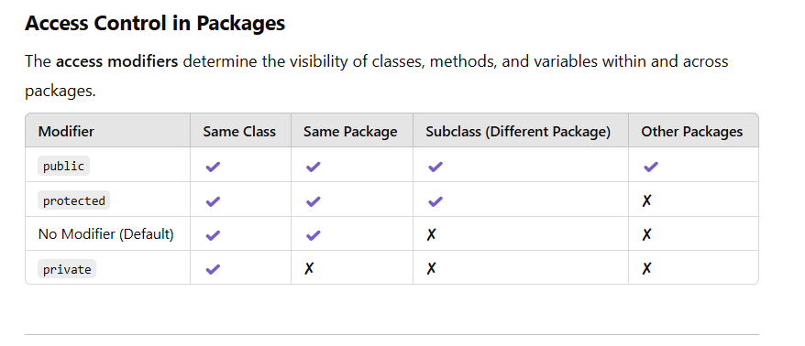

Slide 77
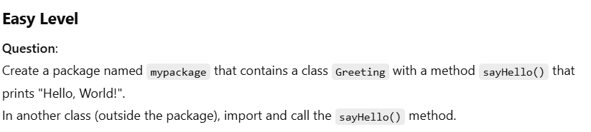
Expected Output:
Hello, World!

Slide 78
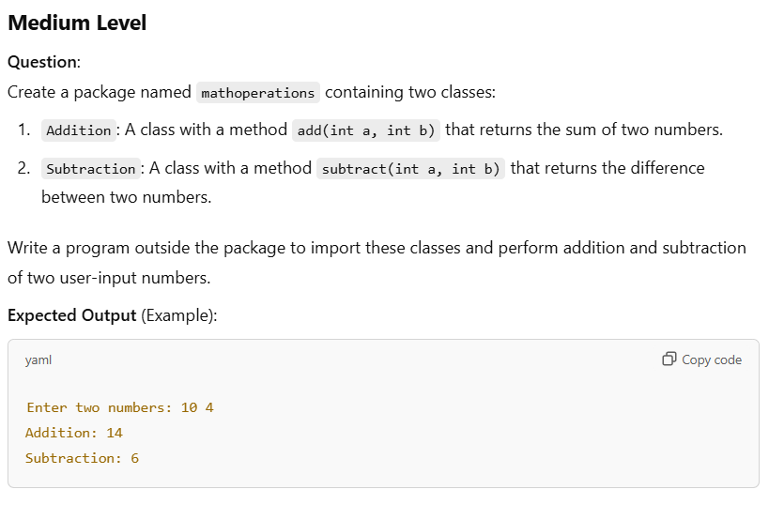

Slide 79
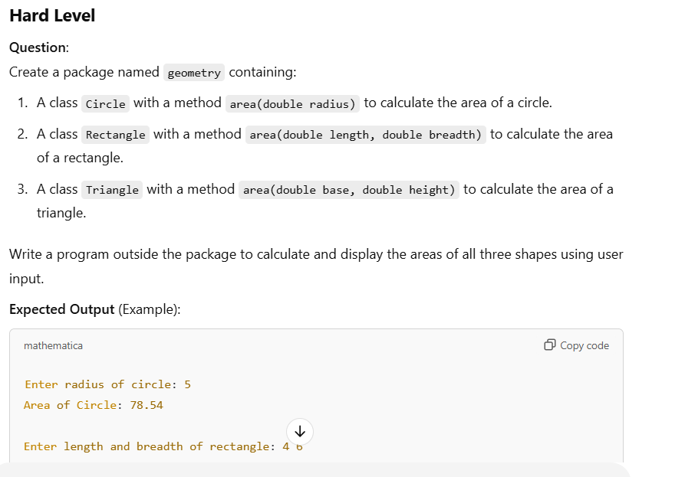

Slide 80
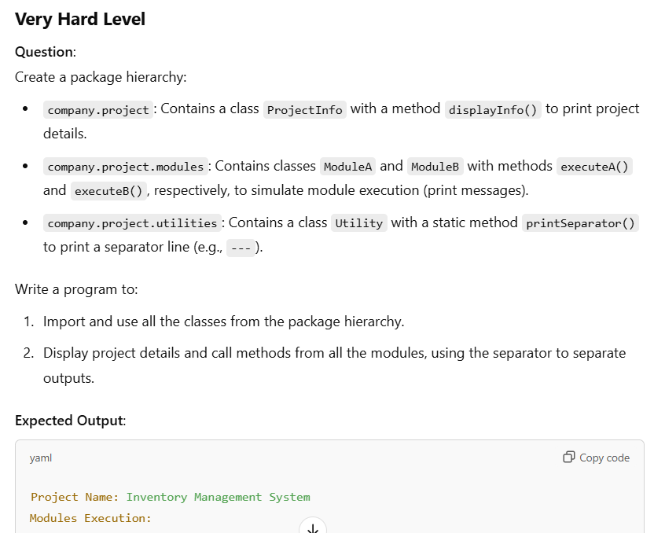

Slide 81
Exception Handling in Java
What is Exception Handling?
Exception handling in Java is a mechanism to handle runtime errors (exceptions) in a controlled way. This prevents program termination and ensures the program can recover from unexpected conditions.
Key Concepts of Exception Handling
Exception:
An event that disrupts the normal flow of a program.
Examples: Division by zero, accessing invalid array indices, file not found, etc.
Error:
Serious problems that applications should not try to handle (e.g., OutOfMemoryError).
Exception Handling:
Java provides a robust framework to catch and handle exceptions using the try-catch block, throw, throws, and finally.

Slide 82
Benefits of Exception Handling
Program Continuity:
Prevents the program from crashing and allows graceful recovery.
Error Identification: Identifies and resolves bugs efficiently.
Encapsulation: Allows handling of specific exceptions while hiding implementation details.
Cleaner Code: Separates error-handling logic from the main logic.
Types of Exceptions
1. Inbuilt Exceptions: Java provides a set of predefined exceptions in packages like java.lang.
Examples:
ArithmeticException: Division by zero.
NullPointerException: Accessing an object with a null reference.
ArrayIndexOutOfBoundsException: Accessing invalid array indices.
FileNotFoundException: File not found during input/output operations.
2. User-defined Exceptions
Developers can create their own exceptions by extending the Exception class or RuntimeException class.
Example: Creating a custom exception for invalid age input.

Slide 83
Checked Exceptions
Must be handled during compile time using try-catch or by declaring them with throws.
Derived from java.lang.Exception.
Examples:
IOException, SQLException.
Code Example:
import java.io.*;
public class CheckedExceptionExample {
public static void main(String[] args) {
try {
FileReader file = new FileReader("nonexistentfile.txt");
} catch (FileNotFoundException e) {
System.out.println("File not found: " + e.getMessage());
}
}
}

Slide 84
Unchecked Exceptions
Occur at runtime and are not checked at compile time.
Derived from java.lang.RuntimeException.
Examples:
ArithmeticException, NullPointerException.
Code Example:
public class UncheckedExceptionExample {
public static void main(String[] args) {
int a = 10, b = 0;
try {
System.out.println(a / b); // Division by zero
} catch (ArithmeticException e) {
System.out.println("Cannot divide by zero: " + e.getMessage());
}
}
}

Slide 85
Components of Exception Handling
try:
Defines a block of code where exceptions may occur.
catch:
Handles exceptions thrown by the try block.
finally:
A block of code that always executes (whether or not an exception is thrown).
throw:
Used to explicitly throw an exception.
throws:
Declares exceptions that a method can throw.

Slide 86
Examples of Exception Handling
Using try-catch
public class TryCatchExample {
public static void main(String[] args) {
int[] arr = {1, 2, 3};
try {
System.out.println(arr[5]); // Invalid index
} catch (ArrayIndexOutOfBoundsException e) {
System.out.println("Array index is out of bounds: " + e.getMessage());
}
}
}

Slide 87
Using finally
public class FinallyExample {
public static void main(String[] args) {
try {
int num = Integer.parseInt("ABC"); // Invalid number format
} catch (NumberFormatException e) {
System.out.println("Invalid number format: " + e.getMessage());
} finally {
System.out.println("This block always executes.");
}
}
}

Slide 88
Creating a User-defined Exception
Example: Invalid Age Exception
java
Copy code
class InvalidAgeException extends Exception {
public InvalidAgeException(String message) {
super(message);
}
}
public class UserDefinedExceptionExample {
public static void main(String[] args) {
int age = 15; // Invalid age
try {
if (age < 18) {
throw new InvalidAgeException("Age must be 18 or above.");
}
} catch (InvalidAgeException e) {
System.out.println("Exception: " + e.getMessage());
}
}
}
Output:
Arithmetic Exception: / by zero
Execution completed.

